Slide 1
Front-end HTML5 Advanced & Programming
TV Product Development
Safaa Elsayed Mahmoud
21/3/2023

Slide 2
Agenda
Forms & UI Components
Tables
Frames
Programming

Slide 3
Forms & UI Components

Slide 4
Forms & UI Components
Form
An HTML form is used to collect user input. The user input is most often sent to a server for processing.
Form Attributes
The action attribute defines the action to be performed when the form is submitted
The target attribute specifies where to display the response that is received after submitting the form.
The default value is _self which means that the response will open in the current window.
_blank | The response is displayed in a new window or tab
_self | The response is displayed in the current window
_parent | The response is displayed in the parent frame
_top | The response is displayed in the full body of the window
framename | The response is displayed in a named iframe
Notes:
Action:Usually, the form data is sent to a file on the server when the user clicks on the submit button.

Slide 5
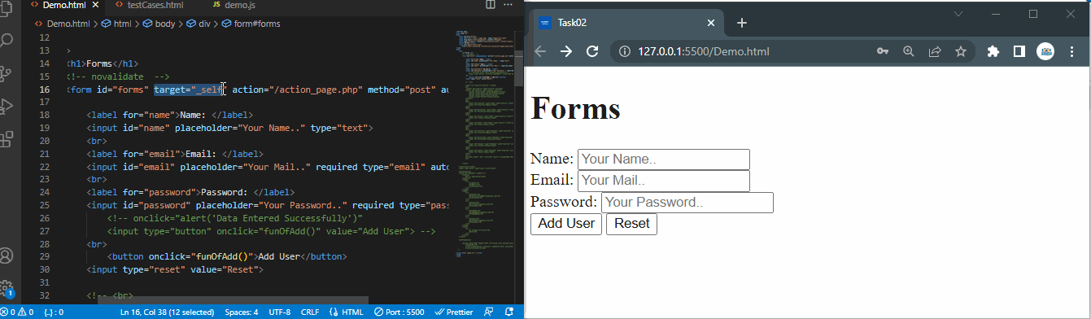

Slide 6
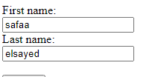
The method attribute specifies the HTTP method to be used when submitting the form data.
The form-data can be sent as URL variables (with method="get") or
as HTTP post transaction (with method="post").
Using get method
Using post method

Slide 7
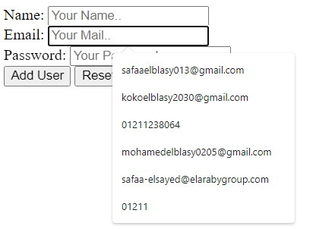
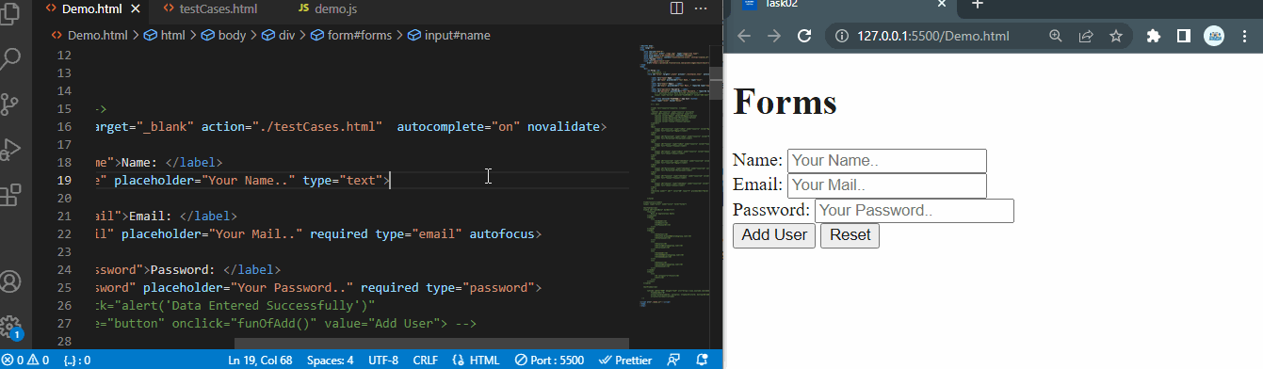
The autocomplete attribute specifies whether a form should have autocompleted on or off. When autocomplete is on, the browser automatically complete values based on values that the user has entered before.
The novalidate attribute is a boolean attribute. When present, it specifies that the form-data (input) should not be validated when submitted.

Slide 8
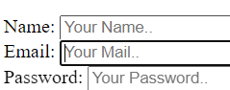
Forms & UI Components
1. Label
read only component that the user can’t edit or remove
The for attribute of <label> must be equal to the id attribute
of the related element to bind them together. A label can also be
bound to an element by placing the element inside the <label> element.

Slide 9
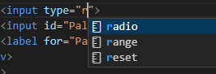
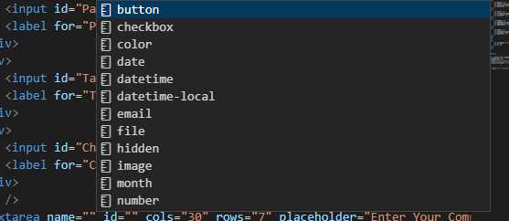
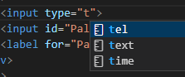
Forms & UI Components
2. Input
is used to create interactive controls for web-based forms to accept data from the user, a wide variety of types of input data and control widgets are available.

Slide 10
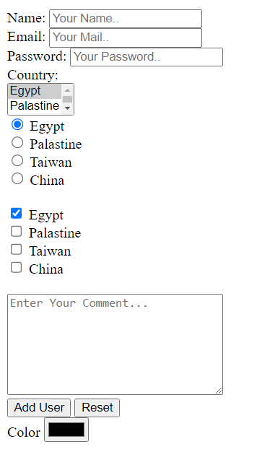
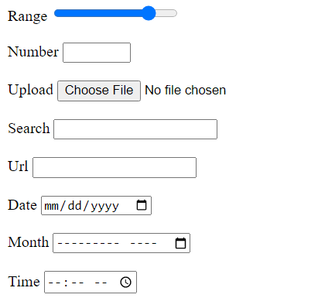
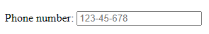
Input types
The <input> element is one of the most powerful and complex in all of HTML due to the sheer number of combinations of input types and attributes.

Slide 11
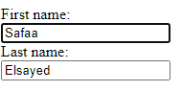
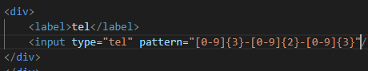
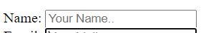
Input attributes
value attribute specifies an initial value for an input field
readonly attribute specifies that an input field is read-only.
disabled attribute specifies that an input field should be disabled.
size attribute specifies the visible width, in characters, of an input field.
The size attribute works with the following input types: text,
search, tel, url, email, and password.
multiple attribute specifies that the user is allowed to enter more than
one value in an input field.
pattern attribute specifies a regular expression that the input field's value
is checked against, when the form is submitted.
placeholder The short hint is displayed in the input field before the user enters a value.
Notes:
A read-only input field cannot be modified (however, a user can tab to it, highlight it, and copy the text from it).
The value of a read-only input field will be sent when submitting the form!
-----------------------------------------------------------
A disabled input field is unusable and un-clickable.
The value of a disabled input field will not be sent when submitting the form!
-------------------------------------------------------------
The multiple attribute works with the following input types: email, and file.

Slide 12
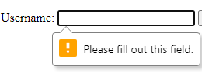
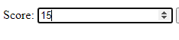
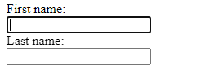
Input attributes
required attribute specifies that an input field must be filled out before submitting the form.
step attribute specifies the legal number intervals for an input field.
autofocus attribute specifies that an input field should automatically get focus when
the page loads.
Notes:
Step This attribute can be used together with the max and min attributes to create a range of legal values.
The step attribute works with the following input types: number, range, date, datetime-local, month, time and week.

Slide 13
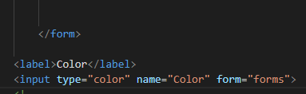
Input attributes
form attribute specifies the form the <input> element belongs to.
The value of this attribute must be equal to the id attribute of the
<form> element it belongs to.

Slide 14
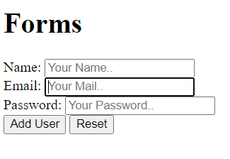
Forms & UI Components
3. Button
is an interactive element activated by a user, Once activated, it then performs an action, such as submitting a form or opening
a dialog.
has same attributes in input component
additional attributes:
Type(submit: The button submits the form
data to the server,
reset: The button resets all the controls to their
initial values)
onClick: that take the function that apply to this button

Slide 15
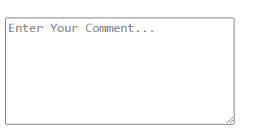
Forms & UI Components
4. Text Area
represents a multi-line plain-text editing control, useful to allow users to enter a sizeable amount of free-form text, for example a comment on a review or feedback form.
-You can set its number of columns and rows
has same attributes in previous components
additional attributes:
minLength, maxLength that define The minimum &maximum number of characters
Spellcheck specifies whether the <textarea> is subject to spell checking by the underlying browser/OS
Default
True
False
Notes:
true: Indicates that the element needs to have its spelling and grammar checked.
default : Indicates that the element is to act according to a default behavior, possibly based on the parent element's own spellcheck value.
false : Indicates that the element should not be spell checked.

Slide 16
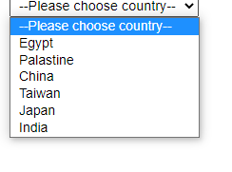
Forms & UI Components
5. Selection
represents a control that provides a menu of options.
Each menu option is defined by an <option> element nested inside the <select>.
Each <option> element should have a value attribute containing the data value
additional attributes:
Size: represents the number of rows
in the list that should be
visible at one time
select
option
Notes:
f the control is presented as a scrolling list box (e.g. when multiple is specified), this attribute represents the number of rows in the list that should be visible at one time. Browsers are not required to present a select element as a scrolled list box. The default value is 0.

Slide 17
Tables

Slide 18
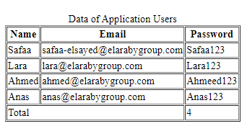
6. Tables :-
thead => Table Header
tbody => Table Body
tfoot => Table Footer
Caption
thead
tbody
tfoot
Notes:
- The <table> HTML element represents tabular data — that is, information presented in a two-dimensional table comprised of rows and columns of cells containing data. - The <caption> HTML element specifies the caption (or title) of a table. -The <thead> HTML element defines a set of rows defining the head of the columns of the table. -The <tbody> HTML element encapsulates a set of table rows (<tr> elements), indicating that they comprise the body of the table (<table>) -The <tfoot> HTML element defines a set of rows summarizing the columns of the table.

Slide 19
Tables :-
tr => Table Row
td => Table Data Cell
th => Table Header Cell
tr
td
Notes:
The <tr> HTML element defines a row of cells in a table. The row's cells can then be established using a mix of <td> (data cell) and <th> (header cell) elements
-The <td> HTML element defines a cell of a table that contains data. It participates in the table model. <td> support the colspan attribute, which lets you specify how many columns wide the cell should be, with the default being 1. Similarly, you can use the rowspan attribute on cells to indicate they should span more than one table row.

Slide 20
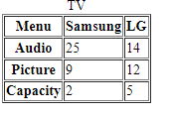
Tables :-
th
Notes:
- The <th> HTML element defines a cell as the header of a group of table cells. The exact nature of this group is defined by the scope and headers attributes.

Slide 21
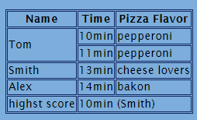
Tables :-
Colspan: To make a cell span over multiple columns
Rowspan: To make a cell span over multiple rows
rowspan
colspan

Slide 22
Frames

Slide 23
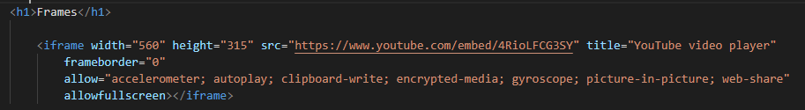

7. Frames
iframe
to call part of website or another HTML page into our page

Slide 24

iframe
How to get it easier..!

Slide 25
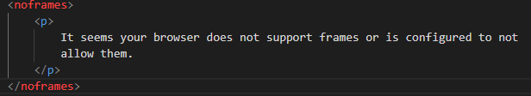
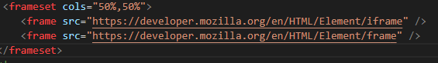
Deprecated..!!
The <noframes> tag was used in HTML 4 present an explanatory message if the user agent
doesn't support frames.
The <frameset> tag was used in HTML 4 to define a frameset.
The <frame> tag was used in HTML 4 to define one particular window (frame) within a <frameset>. defines a particular area in which another HTML document can be displayed
But now !!
In HTML5 we use only <iframe> to do same job

Slide 26
Programming

Slide 27
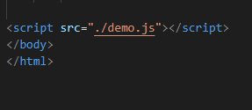
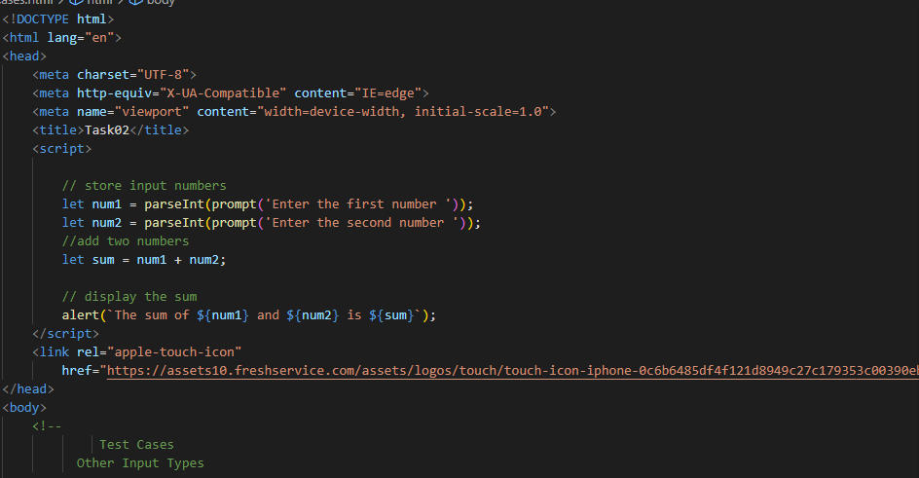
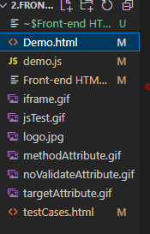
Programming
1. script
The Script element is used in the HTML file for using the JavaScript in the code. JavaScript allows us to enhance the
functionality of the HTML file.
2
➔ <script> tag could exist in two places in code:
1

Slide 28
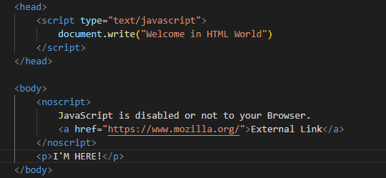
Programming
The noscript element is used to display the alternate text on the browser that does not support scripts.
defines a section of HTML to be inserted if a script type on the page is unsupported or if scripting is
currently turned off in the
browser.
2. noscript
Notes:
Result with scripting enabled in your browser
Im here
Result with scripting disabled in your browser
The External Link
Im here

Slide 29
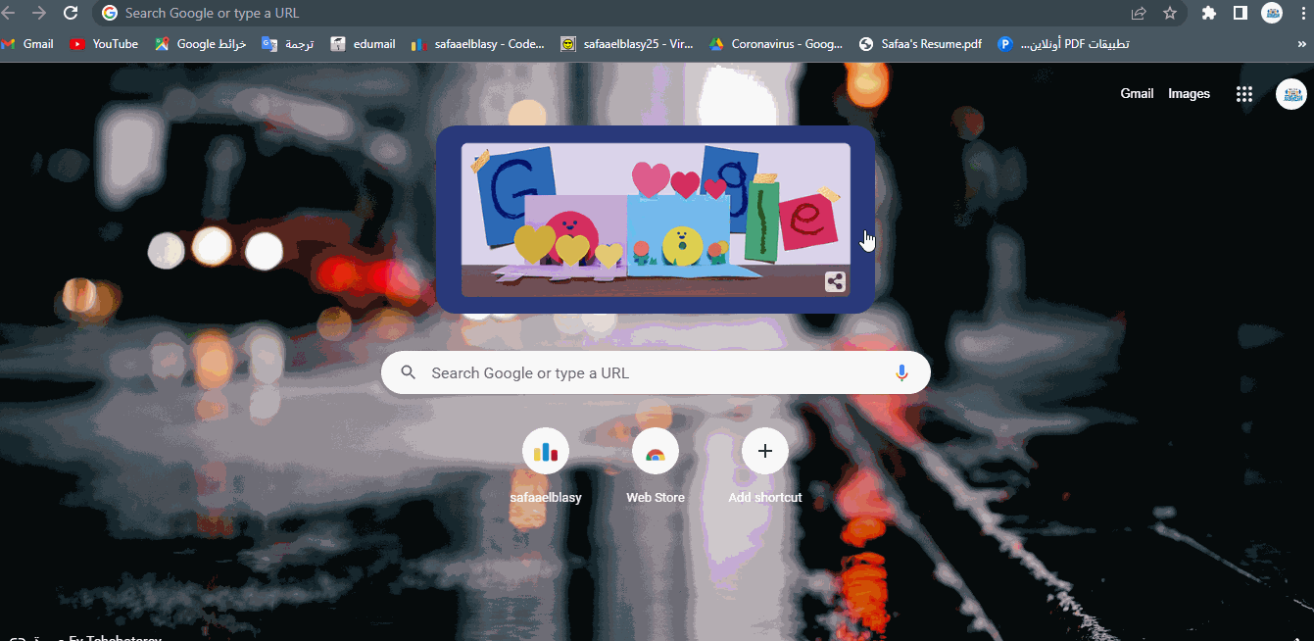
Programming
How to check if your browser enable script or not ?!

Slide 30

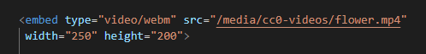
Programming
Deprecated..!!
3. applet
embeds a Java applet into the document
4. embed
embeds external content at the specified point in the document. This content is provided by an external application or other source of interactive content
__ Now we can use iframe instead and do same thing more perfect

Slide 31
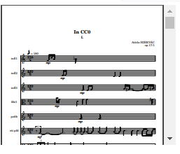
Programming
Deprecated..!!
5. object
represents an external resource, which can be treated as an image
6. param
defines parameters for an <object> element.
__ Now we can use iframe instead and do same thing more perfect

Slide 32
Demo
https://github.com/safaaElsayd/Advanced-HTML.git

Slide 33
Thanks

